Slide 1
An Introduction to Data and Information

Slide 2
Data vs. Information
Data
Information
Discrete items
E.g. price of an item in a supermarket
The type of product listed on a sign over a supermarket aisle
Linking together two or more items of data to provide in item of knowledge
‘50p’ vs. ‘the price of a litre of milk is 50p’
Data becomes information in users’ minds when it informs them, e.g. answers a question like how to use a bus to get from A to B at a particular time

Slide 3
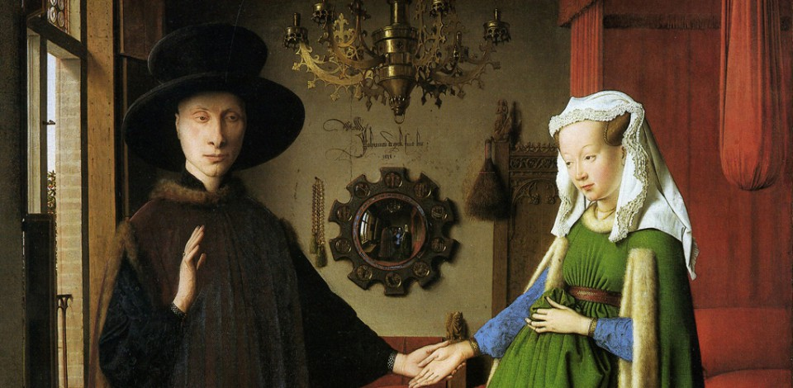
From sensation to symbol
Sensation
Sight, sound, touch, taste, smell and balance → perceptual data
React instinctively vs. respond reflectively
E.g. withdrawing your hand from painfully cold water vs. describe it using languages
What is ART for?

Slide 4
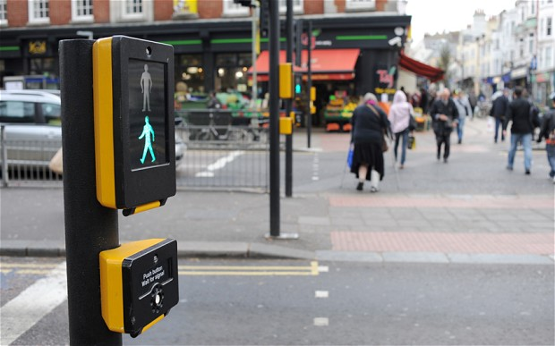
Sign or symbol
Something that conveys some information by means other than direct representation
E.g. a beeping sound at a light-controlled pedestrian crossing(sign), symbolises that it’s safe to cross while the beeping continues
Words are also signs
This meaning is understood by a group of people who agree broadly on what that meaning is.
A sign or symbol is a way of representing data

Slide 5
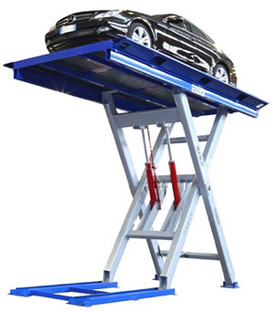
Why do we invent a computer?
Interest in data
Enhance and extend our perception
e.g. telescopes, temperature sensor
Devices to amplify muscle power
Hydraulic lift
Calculate ballistic trajectories
Perceptions of sensations
symbols
Information
Store, analyse, process

Slide 6
A Computer System is the Combination of
The computer (with its processor and storage)
Other equipment such as a scanner or printer
The software programs that make it all work
Applications: software programs that are designed to help with some human tasks

